Slide 1
CNNs:各式CNN

Slide 2
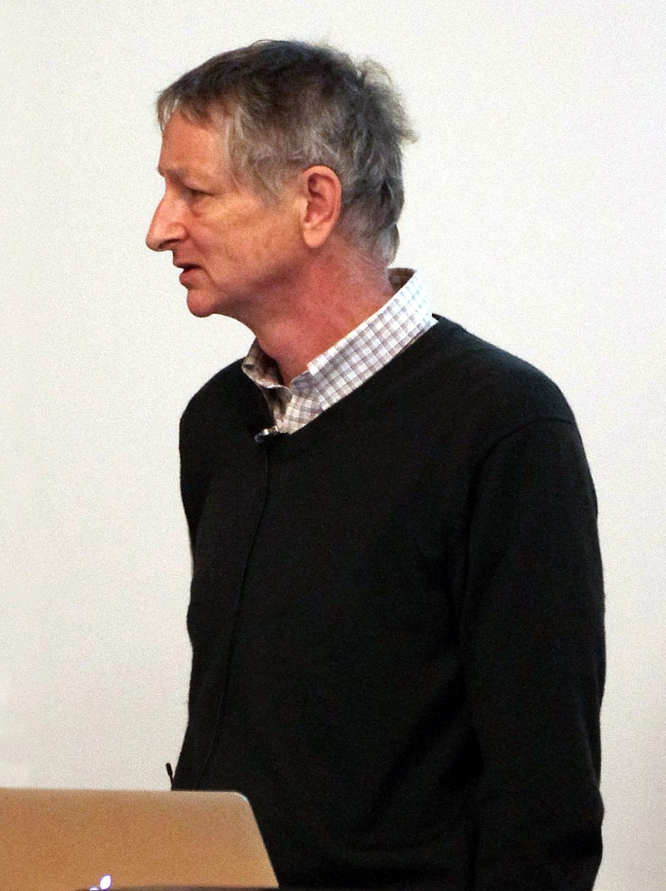
Godfather of Deep Learning
重要里程碑
1986 :the backpropagation algorithm for training multi-layer neural networks
https://www.cs.toronto.edu/~hinton/
Hinton, G. E., Osindero, S. and Teh, Y. (2006)
A fast learning algorithm for deep belief nets.
Neural Computation, 18, pp 1527-1554
2012 AlexNet ( Alex Krizhevsky)啟動AI/NN電腦視覺熱潮
2018 Turing Prize (Yoshua Bengio and Yann LeCun )
2012年在coursera開設課程的簡報https://www.cs.toronto.edu/~hinton/coursera_slides.html

Slide 3
CNN

Slide 4
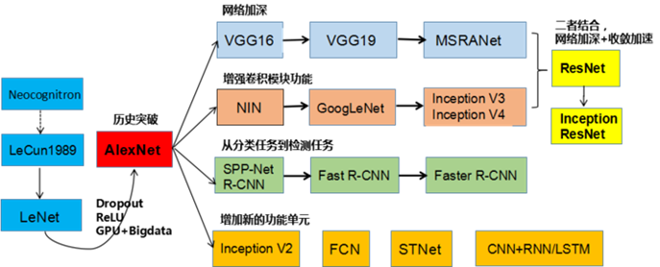
https://medium.com/@rgnuj122/lenet%E6%89%8B%E6%8A%8A%E6%89%8B%E5%AF%A6%E4%BD%9C%E6%95%99%E5%AD%B8-1c2f149c822f

Slide 5
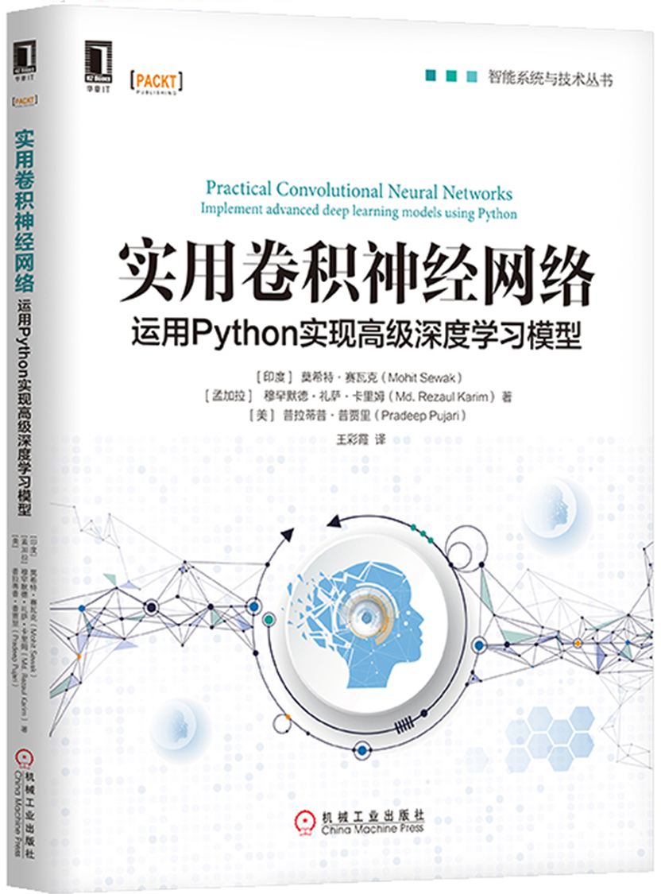
第5章 轉移學習 103
5.1 特徵提取方法 103
5.1.1 目標資料集較小且與原始訓練集相似 104
5.1.2 目標資料集較小且與原始訓練集不同 105
5.1.3 目標資料集很大且與原始訓練集相似 107
5.1.4 目標資料集很大且與原始訓練集不同 107
5.2 轉移學習示例 108
5.3 多工學習 111
第6章 CNN自編碼器 113
6.1 自編碼器介紹 113
6.2 卷積自編碼器 114
6.3 應用 115
第7章 CNN目標檢測與實例分割 119
7.1 目標檢測與圖像分類的區別 120
7.2 傳統的、非CNN的目標檢測方法 124
7.3 R-CNN：CNN特徵區 128
7.4 Fast R-CNN：基於區域快速識別的CNN 130
7.5 Faster R-CNN：基於快速區域生成網路的CNN 132
7.6 Mask R-CNN：CNN實例分割 135
7.7 實例分割的代碼實現 137
7.7.1 創建環境 138
7.7.2 準備COCO資料集資料夾結構 139
7.7.3 在COCO資料集上運行預訓練模型 139
第4章 經典的CNN模型架構 91
4.1 ImageNet介紹 91
4.2 LeNet 92
4.3 AlexNet架構 93
4.4 VGGNet架構 95
4.5 GoogLeNet架構 97
4.5.1 架構洞察 98
4.5.2 inception模組 99
4.6 ResNet架構 99

Slide 6
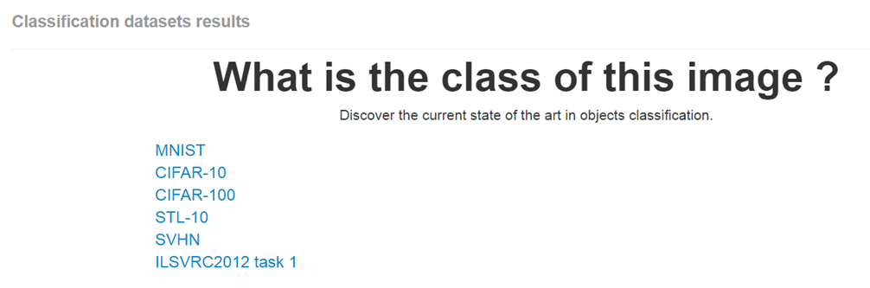
What is the class of this image ?
http://rodrigob.github.io/are_we_there_yet/build/classification_datasets_results.html#4d4e495354

Slide 7
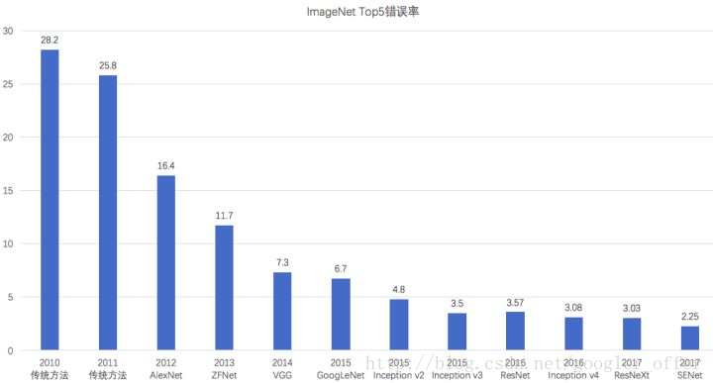
ImageNet上的分類錯誤率逐年降低
且已經低於人類的錯誤率（5.1%）

Slide 8
SENet::Squeeze-and-Excitation Networks(2017-2019)
https://arxiv.org/abs/1709.01507
Caffe實作
https://github.com/hujie-frank/SENet
The central building block of convolutional neural networks (CNNs) is the convolution operator, which enables networks to construct informative features by fusing both spatial and channel-wise information within local receptive fields at each layer.
A broad range of prior research has investigated the spatial component of this relationship, seeking to strengthen the representational power of a CNN by enhancing the quality of spatial encodings throughout its feature hierarchy.
In this work, we focus instead on the channel relationship and propose a novel architectural unit, which we term the "Squeeze-and-Excitation" (SE) block, that adaptively recalibrates channel-wise feature responses by explicitly modelling interdependencies between channels. We show that these blocks can be stacked together to form SENet architectures that generalise extremely effectively across different datasets. We further demonstrate that SE blocks bring significant improvements in performance for existing state-of-the-art CNNs at slight additional computational cost. Squeeze-and-Excitation Networks formed the foundation of our ILSVRC 2017 classification submission which won first place and reduced the top-5 error to 2.251%, surpassing the winning entry of 2016 by a relative improvement of ~25%. Models and code are available at this https URL.

Slide 9
Tensorflow 實作
https://github.com/taki0112/SENet-Tensorflow
PyTorch 實作
https://github.com/moskomule/senet.pytorch
Keras 實作
https://github.com/titu1994/keras-squeeze-excite-network
https://github.com/yoheikikuta/senet-keras
說明文件
https://blog.csdn.net/u014380165/article/details/78006626
keras瞎搞系列-從LeNet到SENet——卷積神經網路回顧
https://blog.csdn.net/googler_offer/article/details/79478893

Slide 10
CNN應用

Slide 11
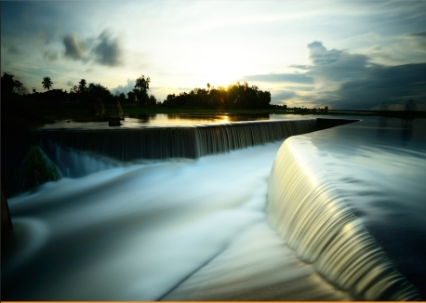

Stylenet / Neural-Style(2015)
A Neural Algorithm of Artistic Style
Leon A. Gatys, Alexander S. Ecker, Matthias Bethge
(Submitted on 26 Aug 2015 (v1), last revised 2 Sep 2015 (this version, v2))
https://arxiv.org/abs/1508.06576
style image
風格
塞尚

Slide 12
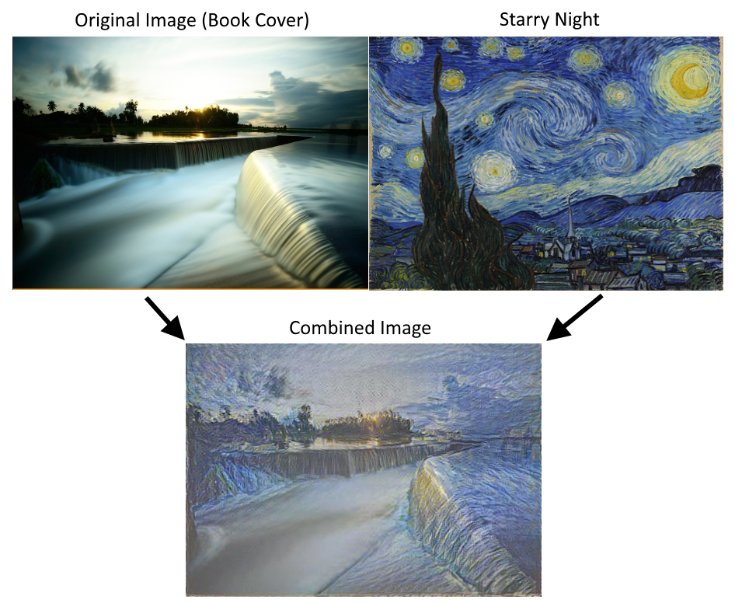

Slide 13
CNN應用

Slide 14
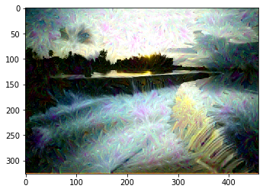
Deep Dream
Convolutional Neural Network image generation
https://github.com/nfmcclure/tensorflow_cookbook/blob/master/08_Convolutional_Neural_Networks/06_Deepdream/06_deepdream.ipynb

Slide 15
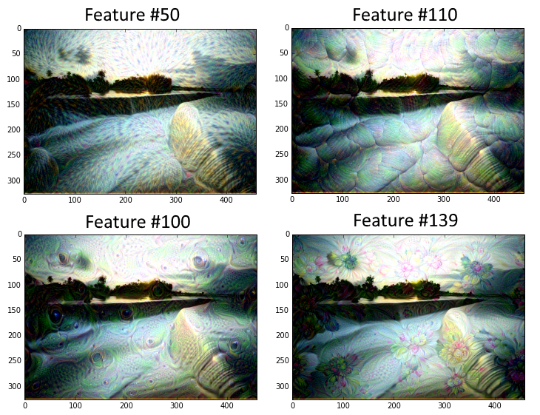

Slide 16
CNN::ref

Slide 17
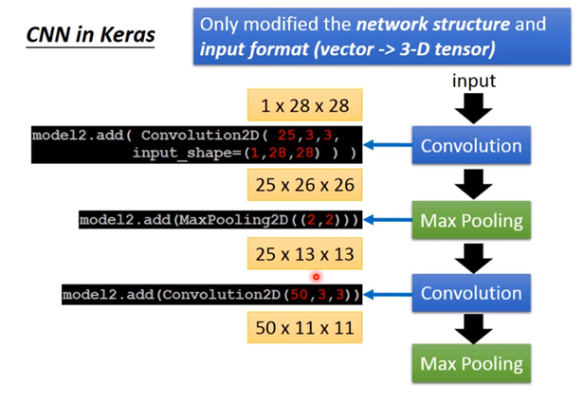
ML Lecture 10: Convolutional Neural Network
https://www.youtube.com/watch?v=FrKWiRv254g

Slide 18
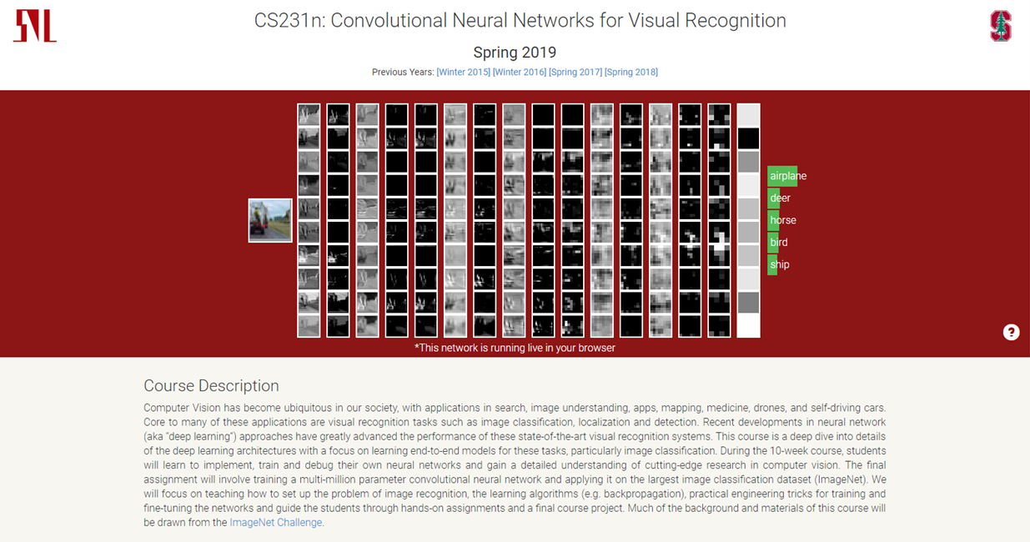
http://cs231n.stanford.edu/
CS231n: Convolutional Neural Networks for Visual Recognition
Spring 2019

